Slide 1


KISLINE Crawler Manual How to use A to Z
Wunhan Park (Cloud), cloud.park@sap.com / (vividxenon@gmail.com)
11 February, 2019

Slide 2

Agenda
Anaconda Installation and Basic environment Set-up
1-1. Download Anaconda 5.0.x
1-2. Install Anaconda 5.0.x
1-3. Check Python Installation
1-4. What is Terminal?
1-5. Install Selenium bindings
Register & Configure
2-1. Register in KISLINE
2-2. (Must) Configure login_information.json
2-3. Configure duns_finder.xlsx for duplicated DUNS number
2-4. Configure massive.xlsx for massive search
How to Run and Use Script
3-1. Go to your directory, and Run Script in Terminal
3-2. Single search - Just follow Direction.
3-3. Massive Search
3-4. Social Listening Search
How to deal with issue

Slide 3
First step:
Download & Install Anaconda.
From here : https://repo.anaconda.com/archive/
Which version? Go to next page!

Slide 4
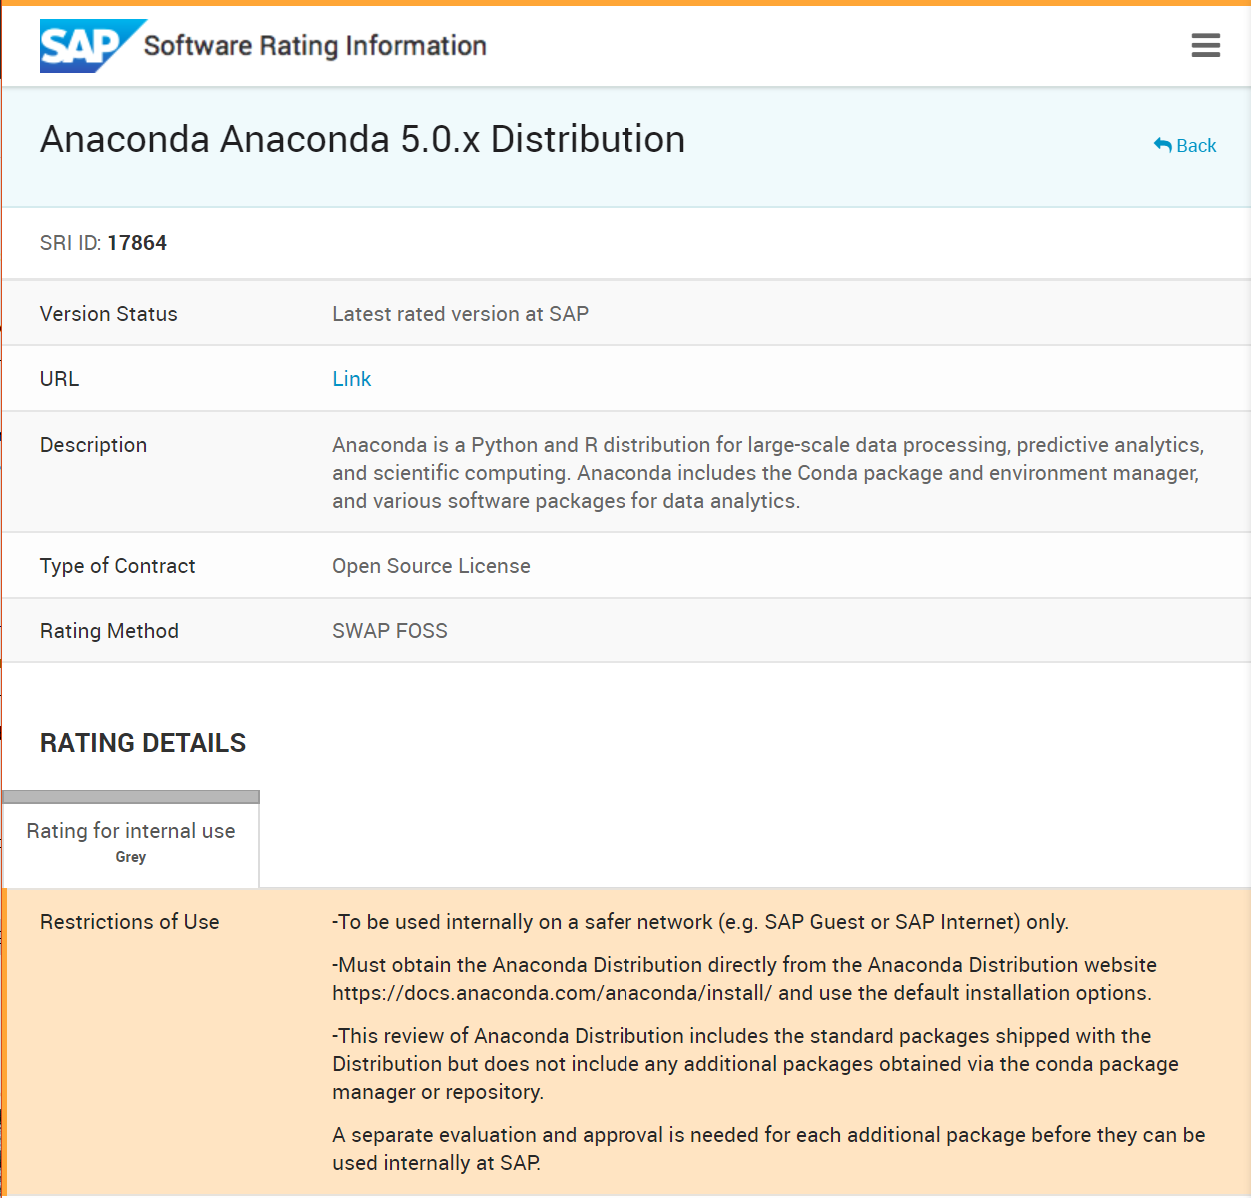
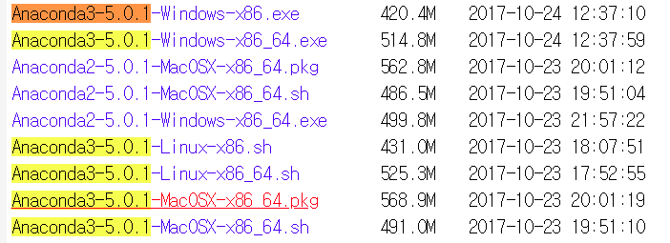
1-1. Download Anaconda 5.0.x
https://repo.anaconda.com/archive/
From above link, please download below version of Anaconda.
Anacond3-5.0.1-Windos-x86_64.exe
(not Anacond3-5.0.1-Windos-x86)

Slide 5
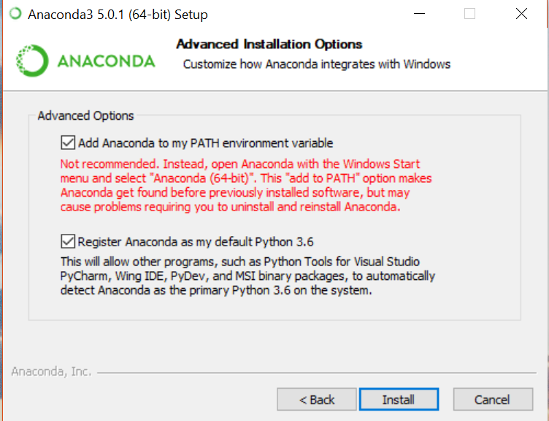
1-2. Install Anaconda 5.0.x
Step1 : Run Anaconda Installer
Step2 : Check ‘Just me’
Step3 : Click Next with default setup
Step4 : Refer to right picture, then check both option
“Add Anaconda to my PATH environment variable”
“Register Anaconda as my default python 3.6”
Important: If you do not check properly, you would suffer whenever you run the code

Slide 6
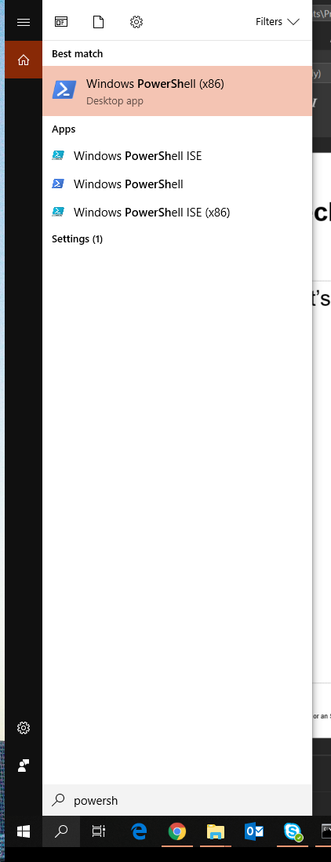
1-3. Check Python Installation
Check whether python is properly installed.
Step 1 : Search ‘Powershell” and Run Powershell
Step 2 : Type python and press Enter
Step 3: Check if below comment is pops up
Step 4: (Optional) Type and Enter
Step 5 : To escape, press (Ctrl + Z) and Enter, or type ‘exit()’
Python 3.6.3 |Anaconda, Inc.| (default, Oct 15 2017, 03:27:45) [MSC v.1900 64 bit (AMD64)] on win32 Type "help", "copyright", "credits" or "license" for more information
>>> print("Hello, DCR Team")
Hello, DCR Team

Slide 7
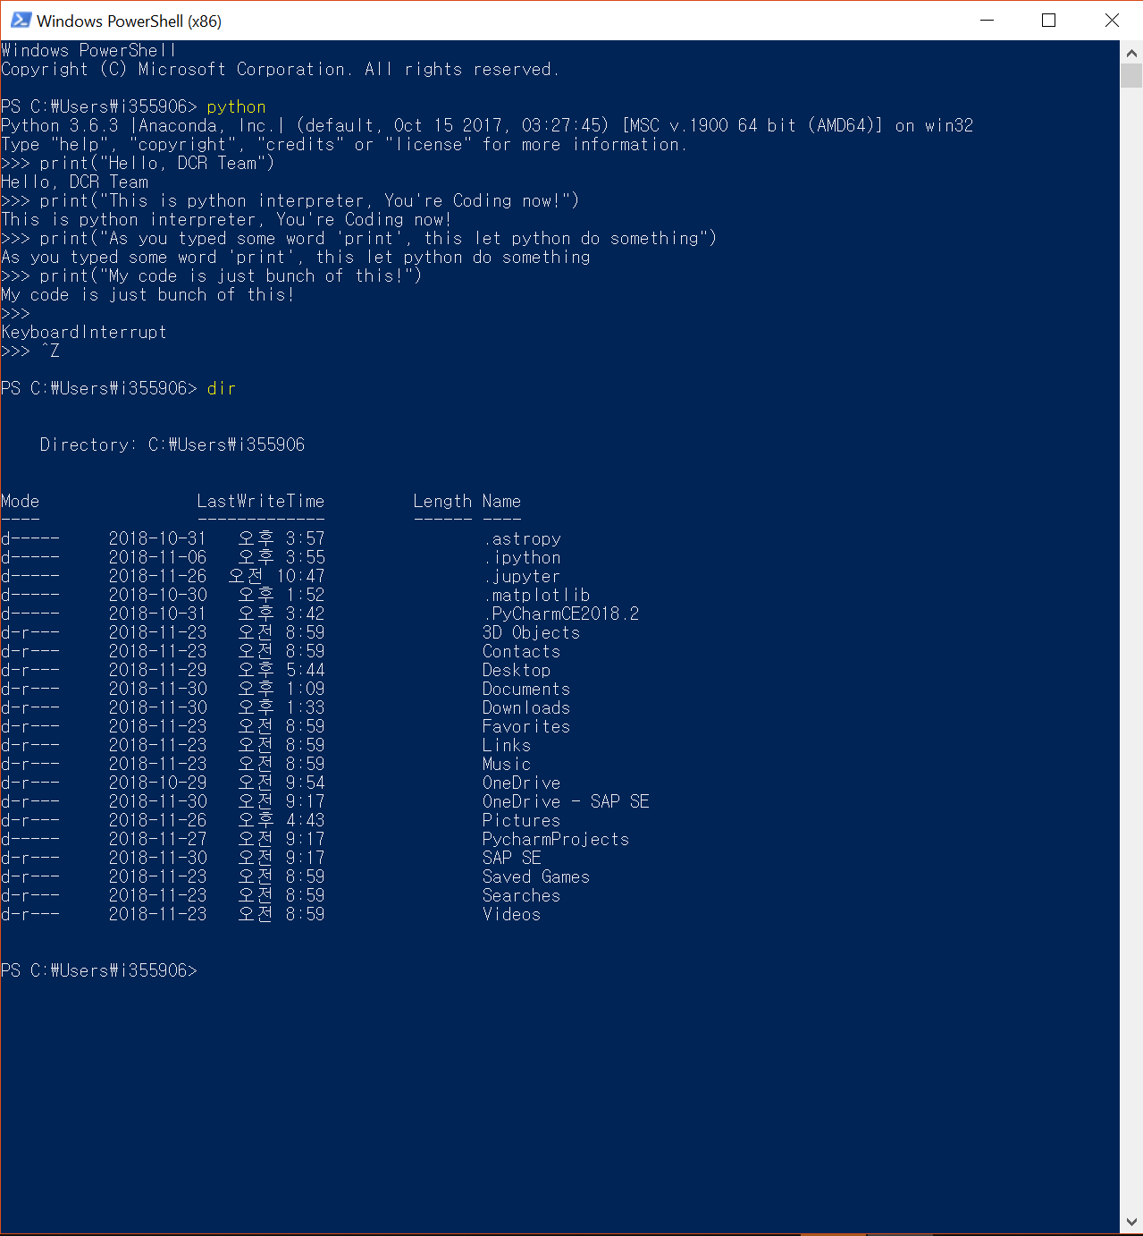
1-4. What is Terminal?
Powershell is one of Command console (Terminal).
Terminal enables running python script.
You can move your directory by some keyword.
* Key Commands:
cd (directory) | Move to directory
cd .. | (Two dot) Move to upper (parent) directory
dir | Show what’s in this directory
python (script name) | Run python script
start . | (Don’t miss dot!) Open directory
* If you put first letter of keyword then press Tap, the word will be
completed automatically.
L (tap) -> Link
python h (tap) -> python hoover.py

Slide 8
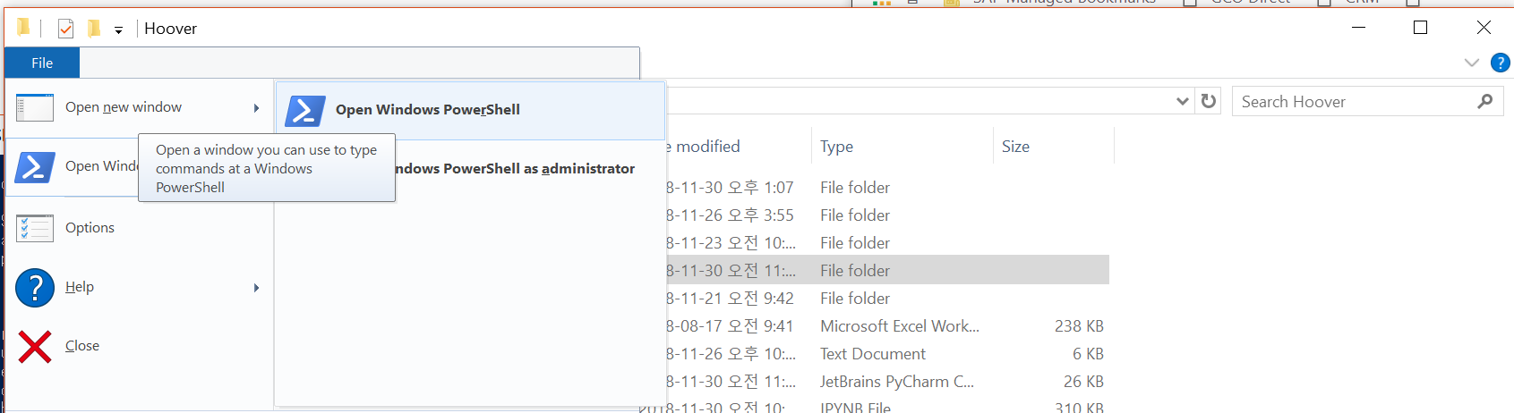
1-4. What is Terminal? (Cont.)
If you are confused, you can find Powershell in ‘File’ tap of File Explorer

Slide 9
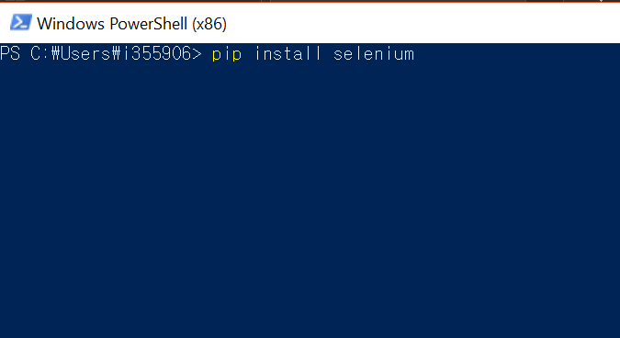
1-5. Install Selenium bindings
Before running the script, we must install python Selenium bindings.
Selenium let python control Web browser like Chrome.
Just type below sentence in terminal.
pip install selenium
Then it will automatically install selenium bindings from python library achieve (pip).

Slide 10
Second step:
Register & Configure
Inside of bundle, there is ‘asset’ folder.
Go through ‘static’ folder, then you will find 3 files.

Slide 11
2-1. Register in KISLINE
We have another license for KISLINE only for DCR team members. This license includes Deepsearch.
Before register, Please ask to Kim, Diane (diane.kim@sap.com).
기업계정 | DCRprofiling1
인증코드 | Listening19!
NEW ID | sapdcrXX (XX varies as number)
NEW PW | profile19!

Slide 12
2-2. Configure login_information.json (Must)
Step 1 : Open ‘login_information.json’ file in asset folder with notepad.
Step 2 : Modify yellow part, and save. Values must be padded with quotation mark (“).
{
"ID" : “YourID",
"Password" : “Your PW",
"MU" : “Your MU",
"Countrycode" : “Your Contrycode",
"inumber" : “Your inumber"
}
{example
"ID" : “sapdcr02",
"Password" : “profile19!",
"MU" : “KOREA",
"Countrycode" : “82",
"inumber" : “I355906"
}

Slide 13
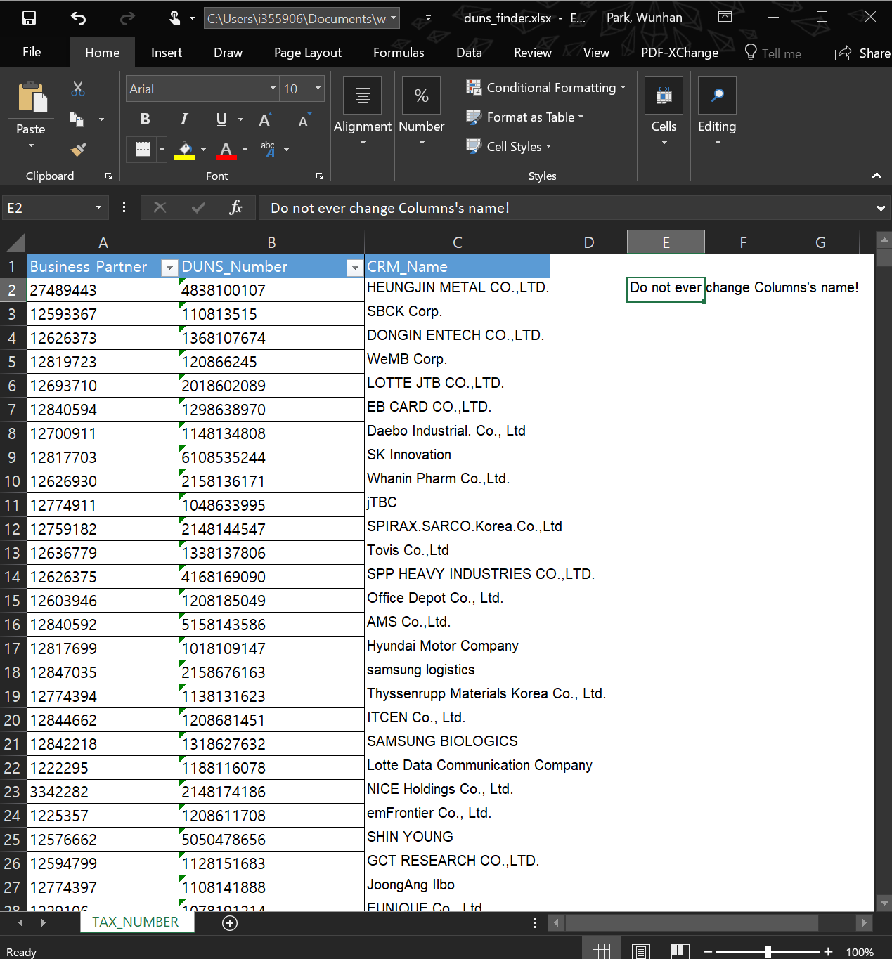
2-2. Configure up-to-date tax_finder.xlsx (Required)
DCR crawler has feature that checks duplicated Tax numbers. Once crawler extracts Tax number from result, crawler compares tax number with ‘tax_finder.xlsx’. Thus, configure tax_finder.xlsx is required.
Step 1 : Request your region’s BP#, Tax, CRM name record to Data Team.
Step 2 : Copy and paste your data.
* Column names should not be changed.

Slide 14
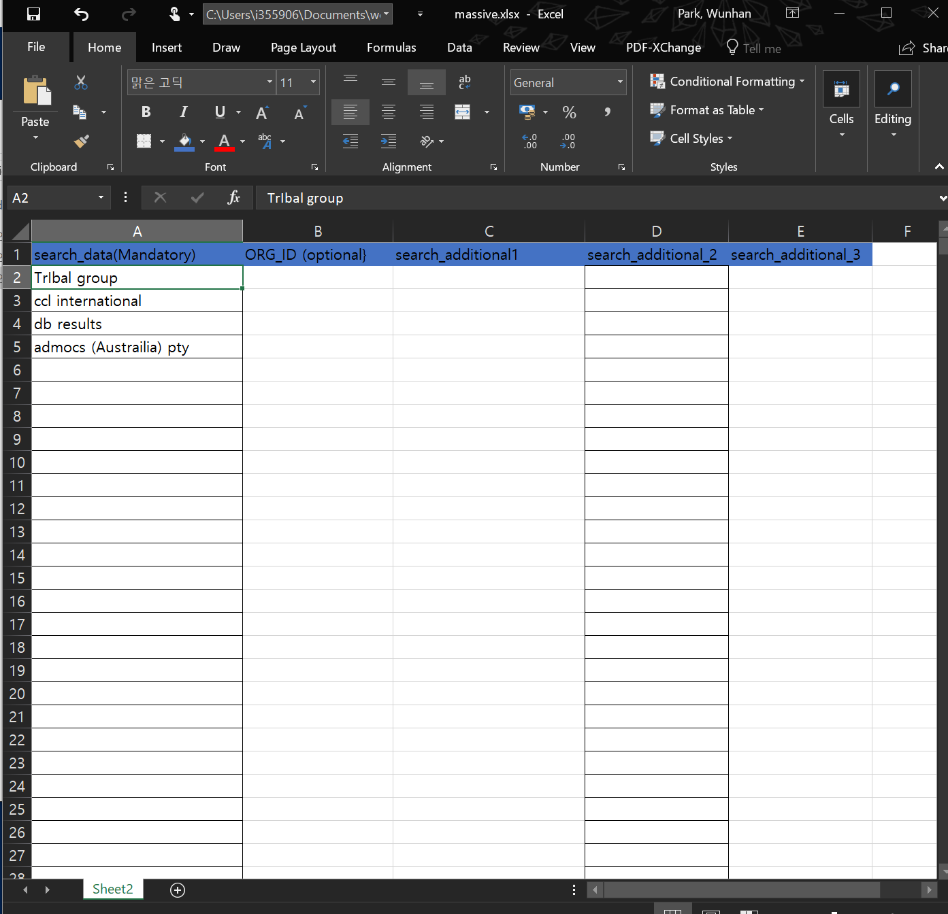
2-3. Configure massive.xlsx (Optional)
DCR crawler has massive search feature, which puts search term automatically in loop.
Step 1 : Open \asset \ static \ massive.xlsx Step 2 : Copy and save search term as you want. And save.
* If you put corresponding ORG_ID in column, and supportive information, Will show you in terminal.

Slide 15
How to Run & Use?
It’s really easy.
Just remember, “python classkisline.py”
It’s Simple as SAP’s “RUN SIMPLE”.

Slide 16
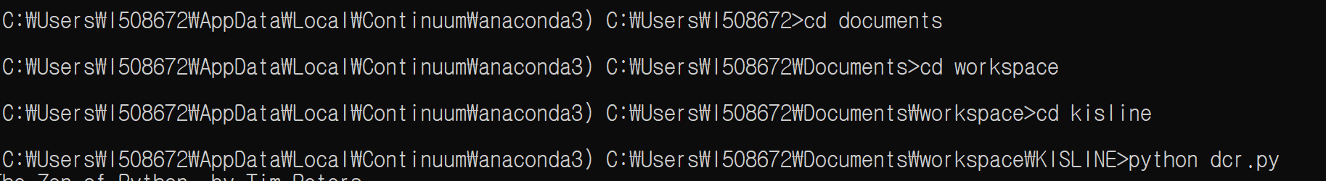
3-1. Go to your directory, and Run Crawler in Terminal
Step 1 : Open Terminal.
Step 2 : Move to your directory that contain crawler using (cd) keyword.
Step 3 : Type “python dcr.py”. (or use autocomplete by press Tab, e.g : ‘python k(Tab)’)
Step 4 : PRESS ENTER, then it’ll run! Run Simple!

Slide 17

3-2. Single search
When you run the crawler, Chrome will pop up.
Step 1 : Put ‘search term’.
If you put ‘9999’, massive search mode will be turned on. Else, ‘1212’ will turn on Social Listening mode.
Step 2 : Follow the direction on the terminal.
Put 0, If you want end the crawler.
Put new search term, if you want to continue searching.
Step 3 : Go to EXCEL folder in directory and check the result.
Shortcut : Type “start .” in terminal.
Step 4 : Click rows, and copy & paste on DCR Template.

Slide 18


3-3. Massive Search
You can use Massive Search mode, which puts search term in loop automatically. Massive.xlsx should be configured.
Step 1 : Put 9999 and Select crawling mode.
If you fail to put Search term 9999, press CTRL + C to terminate crawler, and run again.
0: Normal Massive : Normal DCR template 1 : Juju Massive : Include stakeholder after DCR template 88 : UGB Massive : Include net profit, operating profit and other useful Information
Step 2 : Put starting number.
Loop number and row number on massive.xlsx are different. Only number is accepted.
Step 3 : While it’s running, if you want to stop and save, press Ctrl + C.
If you press Ctrl + C, it will try to terminate crawler and save the results.
Terminating by Ctrl + C is only available when you are not in input mode (while prompt is blinking).
If terminal doesn’t respond to your action (e.g input mode), press Ctrl + C once more.
Step 4 : : Go to EXCEL folder in directory and check the result.
Shortcut : Type “start .” in terminal.
Step 5 : Click rows, and copy & paste on DCR Template.
Keep in a Loop!

Slide 19
3-3. Massive Search – Possible result cases
User action should be different upon number of results.
Number of Results
Available User Action
Expected event
(Press 0) Leave it empty (Terminate This loop)
Put new keyword in Terminal, Then click company what you want. Then press enter twice.
Press 0 : Will generate empty row
Enter twice : Extract Information
0 Results
No action need. Crawler automatically moves to result page.
Only 1 Results
Will extract information, and continue to next loop
Will extract information and will move on to next loop
More than 1 Results
Crawler asked to select result. Select company then press Enter twice.
If there is no result you want, you can leave it empty (Press 0).
Put new keyword (should be more than 3 characters) so that crawler can perform new search.
Will generate empty row
New keyword will be assigned while loop is still hanged on.

Slide 20


3-4. Social Listening Search
For easy profiling, It has Social Listening Search mode.
Step 1 : Put 1212 when asked Seacrh term, and Select crawling mode.
Step 2 : Put Search term what you want.
Step 3 : While it’s running, if you want to stop and save, press Ctrl + C.
If you press Ctrl + C, it will try to terminate crawler and save the results.
Terminating by Ctrl + C is only available when you are not in input mode (while prompt is blinking).
If terminal doesn’t respond to your action (e.g input mode), press Ctrl + C once more.
Step 4 : : Go to EXCEL folder in directory and check the result.
For your convenience. It will extract both social listening – formatted file and DCR template file together.
Step 5 : Click rows, and copy & paste on Social Listening Template.
Lead…
IPO…
bdbd….
SocialListening

Slide 21
How to deal with issue

Slide 22

Caution :
Guided KS CODE and AE mapping, Segments are all only based on KISLINE information, which is rule-based, not considered Account’s PE & any other surrounding conditions.
KISLINE system blocks +500 account search per day or too many access in short period. To evade blocked, crawler stop every 10 second per 5 search in massive mode. Even exceed +500 search, you can continue to use. But next day, you will find error notice.
<POC of KISLINE>
- 이남주 (Lee, Nam Joo) 과장
- 010-4749-0553

Slide 23
One More Thing
:KuksaeKuksae

Slide 24

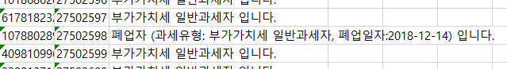
About KuksaeKuksae
Kuksaekuksae is Tax number verifier from NTS.
It’s use is almost same – Mapped Search Tax number on massive.xlsx,
Then Run the code. Then it returns same as below NTS site’s states.
KuksaeKuksae
https://teht.hometax.go.kr/websquare/websquare.html?w2xPath=/ui/ab/a/a/UTEABAAA13.xml
KuksaeKuksae

Slide 25
Thank you.
WUNHAN PARK (Cloud)
DCR APJ KOREA INTERN
Cloud.park@sap.com

